Slide 1
Securing understanding of rounding
Estimation and rounding

Slide 2
how to use Oak lessons

Slide 3
I can recognise when values have been rounded and state sensible suggestions of what the unrounded value could have been.

Slide 4
A conjecture is a (mathematical) statement that is thought to be true but has not been proved yet.
A degree of accuracy shows how precise a number or measurement is.
E.g. to the nearest cm, nearest 10, 1 d.p., etc.

Slide 5

Securing understanding of rounding
Unrounded numbers
Degrees of accuracy

Slide 6
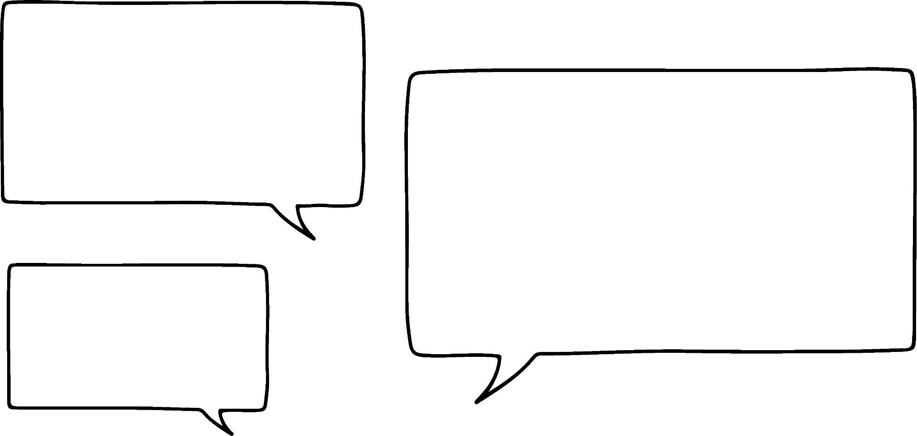

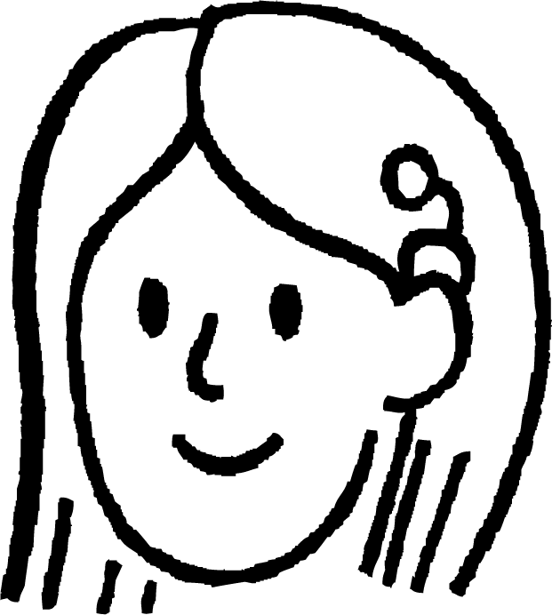
Unrounded numbers
Attendance at the 1966 World Cup:
97 000
Steps taken to get to the moon:
400 000 000
The government spent £172 billion on grants in 2021 to 2022
Population of the UK:
67.33 million
Jun and Sofia are talking about these facts.
Do you think these are the exact values?
It seems very unlikely.
Do you think these are the exact figures?
It does seem very unlikely that they are the exact actual figures.
Jun
Sofia

Slide 7
Unrounded numbers
In certain situations it is not necessary to know the exact value unless you are working within a given degree of accuracy.
Attendance at the 1966 World Cup:
97 000
We did not need to know the exact value to get a sense of the number of people at the match.
I think that this number has been given to the nearest thousand.
Do you agree with Sofia?
It certainly looks as though it has been rounded to the nearest thousand.
Jun
Sofia

Slide 8
Unrounded numbers
Attendance at the 1966 World Cup:
97 000
There must have been more than 97 000 people at the match.
Jun, remember when we drew out number lines we went to the multiple above and below the value.
96 000
97 000
98 000
Jun
Sofia
We could make a conjecture about the exact attendance. E.g. 96 782, 97 005, 97 499.

Slide 9











Unrounded numbers
The government spent £172 billion on grants in 2021 to 2022
Steps taken to get to the moon:
400 000 000
Population of the UK:
67.33 million
billion
100 million
10 thousand
What do you think each of the above has most likely been rounded to?
HMn | TMn | Mn | HTh | TTh | Th | H | T | O | T | H | Th | TTh
 | 6 | 7 | 3 | 3 | 0 | 0 | 0 | 0
th
th
th
th
.

Slide 10
Unrounded numbers
Jun is thinking of a number. He uses rounding to give clues.
After each clue Sofia writes down her guess of the number.
Will her answer change each time?
It is 4530 to the nearest ten.
Sofia guesses 4528.4
It is 5000 to the nearest thousand.
Sofia guesses 4550
It is 4500 to the nearest hundred.
It is 4528 to the nearest whole number.
Sofia guesses 4528
Sofia guesses 4800
Sofia’s guess changed each time. Did yours?

Slide 11
Unrounded numbers
What number am I? (you will get 5 clues)
Clue 1 − when rounded to the nearest thousand I am 2000.
Clue 2 − when rounded to the nearest hundred I am 2000.
Clue 3 − when rounded to the nearest ten I am 1980.
Clue 4 − I am a multiple of 5.
Clue 5 − I am not any of the rounded values.
I am 1975

Slide 12
Unrounded numbers
Sofia is thinking of some numbers. She uses rounding to give two clues. After each clue, guess her number and write it down. Does your guess change each time?
a)
Clue 1
Clue 2
It is 300 to the nearest hundred.
It is 290 to the nearest ten.

Slide 13
Unrounded numbers
Sofia is thinking of some numbers. She uses rounding to give two clues. After each clue, guess her number and write it down. Does your guess change each time?
b)
Clue 1
Clue 2
It is 300 to the nearest hundred.
It is 320 to the nearest ten.

Slide 14
Unrounded numbers
Sofia is thinking of some numbers. She uses rounding to give two clues. After each clue, guess her number and write it down. Does your guess change each time?
c)
Clue 1
Clue 2
It is 300 to the nearest hundred.
It is 250 to the nearest ten.

Slide 15
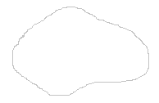
Unrounded numbers
2) Jun’s homework has been damaged by his dog!
His answers are still there but some of the numbers are missing from the questions.
What could the missing numbers be?
331 to the nearest hundred is 300
478 to the nearest thousand is 0
1785 to the nearest hundred is 1800
4995 to the nearest thousand is 5000
397 to the nearest ten is 400

Slide 16
Unrounded numbers
3) a) Are these statements always, sometimes or never true?
b) Give some examples to show why.
A number rounded to the nearest 10 will be less than 5 away from the original number.
A number rounded to the nearest 10 will have two digits.
A number rounded to the nearest 10 will end in one zero.

Slide 17
Unrounded numbers
Sofia is thinking of some numbers. She uses rounding to give two clues. After each clue, guess her number and write it down. Does your guess change each time?
a)
Clue 1
Clue 2
e.g. 282 292 Yes
It is 300 to the nearest hundred.
It is 290 to the nearest ten.

Slide 18
Unrounded numbers
Sofia is thinking of some numbers. She uses rounding to give two clues. After each clue, guess her number and write it down. Does your guess change each time?
b)
Clue 1
Clue 2
e.g. 329 317 Yes
It is 300 to the nearest hundred.
It is 320 to the nearest ten.

Slide 19
Unrounded numbers
Sofia is thinking of some numbers. She uses rounding to give two clues. After each clue, guess her number and write it down. Does your guess change each time?
c)
Clue 1
Clue 2
e.g. 254
254
No
It is 300 to the nearest hundred.
It is 250 to the nearest ten.

Slide 20
Unrounded numbers
2) Jun’s homework has been damaged by his dog!
His answers are still there but some of the numbers are missing from the questions.
What could the missing numbers be?
331 to the nearest hundred is 300
478 to the nearest thousand is 0
e.g 1785 to the nearest hundred is 1800
4995 to the nearest thousand/hundred/ten is 5000
397 to the nearest ten is 400

Slide 21
Unrounded numbers
3) a) Are these statements always, sometimes or never true?
b) Give some examples to show why.
A number rounded to the nearest 10 will have two digits.
A number rounded to the nearest 10 will end in one zero.
A number rounded to the nearest 10 will be less than 5 away from the original number.
All statements are sometimes true.
E.g. 192 to the nearest 10 is 190 and has 3 digits.
E.g. 1995 to the nearest 10 is 2000 and ends in 3 zeros.
E.g. 195 to the nearest 10
is 200 and is 5 away from the original number.

Slide 22
Securing understanding of rounding
Unrounded numbers
Degrees of accuracy

Slide 23
Degrees of accuracy
The degree of accuracy we choose is often dependent on the context.
Attendance at the 1966 World Cup:
97 000
Steps taken to get to the moon:
448 000 000
nearest thousand
nearest million
The government spent £172 billion on grants in 2021 to 2022
Population of the UK:
67.33 million
nearest billion
nearest ten thousand

Slide 24
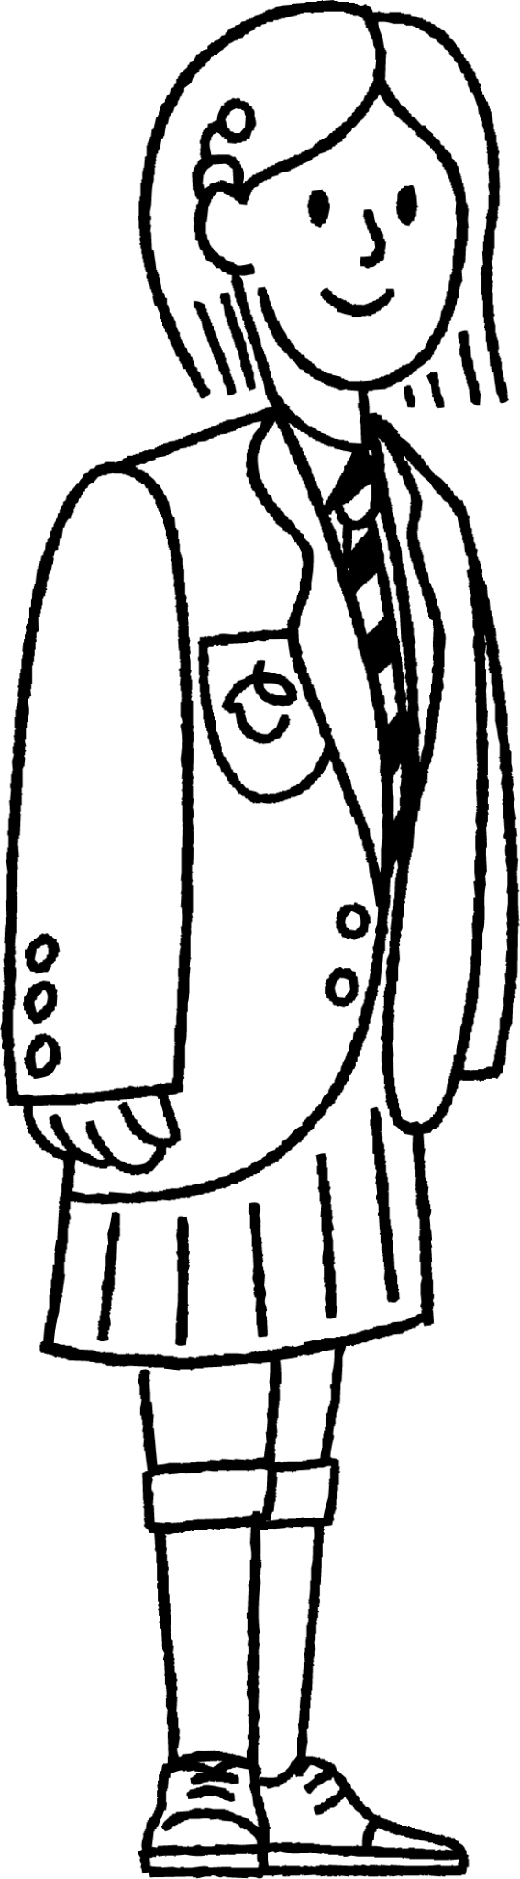
Degrees of accuracy
What would be the appropriate degree of accuracy?
The number of pupils at my school.
We could be given the exact number of pupils.
Rounding to the nearest 10 would also be appropriate.
Sofia

Slide 25
Degrees of accuracy
What would be the appropriate degree of accuracy?
The population of my village.
Rounding this to the nearest 100 would give us an idea of the size of the village.
Sofia

Slide 26
Degrees of accuracy
What would be the appropriate degree of accuracy?
The number of people attending a music festival.
Rounding this to the nearest 1000 would give us an idea of the size of the festival.
Sofia

Slide 27
Degrees of accuracy
What would be the appropriate degree of accuracy?
It often depends on what units we are using to measure.
What is the smallest unit of length we can reasonably measure to?
Centimetre
What would an appropriate degree of accuracy if we measure in centimetres?
The nearest centimetre (integer).
What about if we measure in metres?
The nearest centimetre, which would be 2 decimal places.
My height.
Sofia

Slide 28

Degrees of accuracy
Which of the following would be an appropriate degree of accuracy for the population of London?
Nearest billion
Nearest million
Nearest hundred thousand
Nearest ten

Slide 29
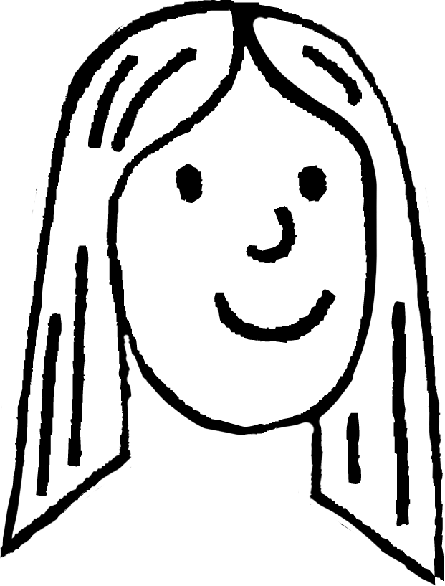
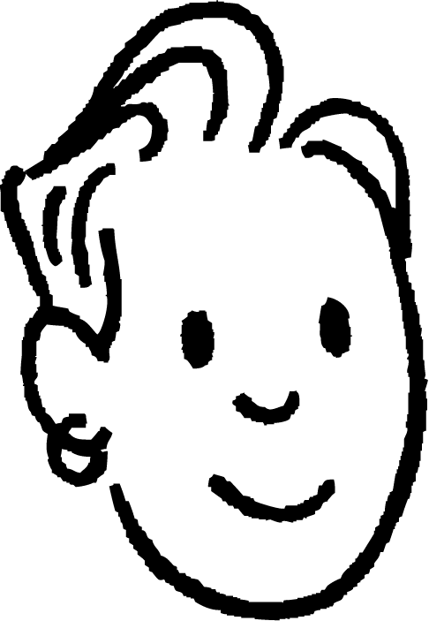
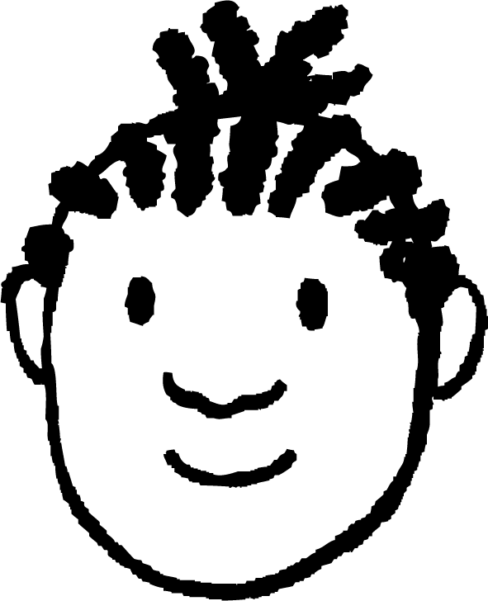
Degrees of accuracy
We will now look at some other contexts when an appropriate degree of accuracy is important.
Laura, Sam and Jacob decide to buy their teacher a gift to say thank you.
We each have to pay the same amount.
I’ll work it out, I need to do 10 ÷ 3.
The gift cost £10.
Laura
Sam
Jacob

Slide 30
Degrees of accuracy
What does that work out as each Jacob?
The calculator gave me an answer of 3.3333333
We pay £3.33 each then.
Laura
Jacob
Sam
If they each pay £3.33 have they covered the cost of the gift?
No, 3 × £3.33 = £9.99.

Slide 31
Degrees of accuracy
Year 8 from Oak Academy are going on a school trip.
162 pupils and 15 members of staff are going on the trip.
Each coach can carry 52 people.
How many coaches are needed?
I need to give my answer to the nearest integer.
177 ÷ 52 = 3.4…
You need 3 coaches as 3.4 rounds to 3.
Do you agree with Jacob?
If you don’t what mistake has he made?
Jacob’s calculation is correct but he needs to round up to have enough seats for everyone.
Jacob

Slide 32
Degrees of accuracy
Match each statement to the most appropriate degree of accuracy.
The number of sweets in a bag
Nearest million
The population of the UK
Nearest hundred
The number of people at a national sporting event
Nearest ten
Cost of a holiday
Nearest thousand

Slide 33
Degrees of accuracy
Match each statement to the most appropriate degree of accuracy.
Length of a pencil in centimetres
Nearest integer
The length of a piece of ribbon in metres
1 decimal place
Width of a doorway in metres
2 decimal places
Capacity of a mug in millilitres
3 decimal places

Slide 34
Degrees of accuracy
3) Answer the following, making sure that you carefully consider the appropriate degree of accuracy.
Izzy collects 100 eggs. Boxes hold 6 eggs. How many boxes does Izzy need for all her eggs?
Jun decides to share his bag of 200 sweets with Sofia and Sam. They each get the same number of sweets. How many do they each get?

Slide 35
Degrees of accuracy
3) Answer the following, making sure that you carefully consider the appropriate degree of accuracy.
c) Aisha has baked 150 cookies for the school fete. She is putting them into boxes of 4. How many boxes can Aisha make?
d) A group of 56 scouts are going on a camping trip. Each tent sleeps 6. How many tents are needed for the scouts?

Slide 36
Degrees of accuracy
Match each statement to the most appropriate degree of accuracy. The holiday could be nearest hundred or thousand.
The number of sweets in a bag
Nearest million
The population of the UK
Nearest hundred
The number of people at a national sporting event
Nearest ten
Cost of a holiday
Nearest thousand

Slide 37
Degrees of accuracy
Match each statement to the most appropriate degree of accuracy.
Length of a pencil in centimetres
Nearest integer
The length of a piece of ribbon in metres
1 decimal place
Width of a doorway in metres
2 decimal places
Capacity of a mug in millilitres
3 decimal places

Slide 38
Degrees of accuracy
3) Answer the following, making sure that you carefully consider the appropriate degree of accuracy.
Izzy collects 100 eggs. Boxes hold 6 eggs. How many boxes does Izzy need for all her eggs? 100 ÷ 6 = 16.667, Izzy needs 17 boxes.
Jun decides to share his bag of 200 sweets with Sofia and Sam. They each get the same number of sweets. How many do they each get? 200 ÷ 3 = 66.667, they each get 66 sweets.

Slide 39
Degrees of accuracy
3) Answer the following, making sure that you carefully consider the appropriate degree of accuracy.
c) Aisha has baked 150 cookies for the school fete. She is putting them into boxes of 4. How many boxes can Aisha make? 150 ÷ 4 =37.5, Aisha can make 37 boxes of cookies.
d) A group of 56 scouts are going on a camping trip. Each tent sleeps 6. How many tents are needed for the scouts? 56 ÷ 6 = 9.333, they will need 10 tents.

Slide 40
Securing understanding of rounding
Using our method of rounding we are able to make conjectures about the unrounded numbers.
The degree of accuracy often depends on the context of the question.
In some contexts, numbers which would normally round down have to round up. E.g. To pay for a £10 gift you would round up.
£10 ÷ 3 = 3.333333, rounds up to £3.34
In some contexts, numbers which would normally round up have to round down. E.g. To make necklaces of 15 beads you would round down.
100 ÷ 15 = 6.667, rounds down to 6 necklaces

Slide 41

© Oak National Academy 2024.
Produced in partnership with Mathematics in Education and Industry.
Licensed on the Open Government Licence v3.0, except where otherwise stated. See Oak terms and conditions.

